Slide 1
HANDWRITTEN DIGITS
RECOGNIZER
End of Studies Project Presentation

Slide 2
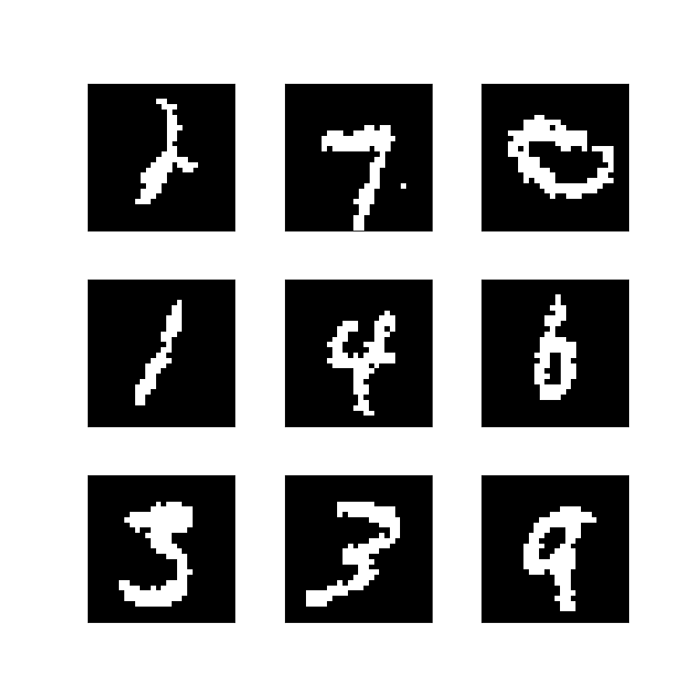
HANDWRITTEN DIGITS RECOGNIZER
This software was created, in a period of 4 months, as a graduation project at the Agadir Higher School of Technology – Ibn Zohr University
Created by
Miss. Kaoutar SOUGRATI
Mr. Ayoub LAMFADLI
Mr. Hamza AIT BOURHIM
Supervised by
Dr. Mustapha AMROUCH

Slide 3


Plan
Introduction
General context and problematic
Handwritten digits recognition
Development Tools
Simulation
Conclusion

Slide 4
Introduction
Before digging into our project, let’s clarify the difference between the terms AI, ML and DL to avoid any confusions.
Artificial Intelligence is a science like mathematics or biology. It studies ways to build intelligent programs and machines that can creatively solve problems.
Machine Learning is a subset of artificial intelligence (AI) that provides systems the ability to automatically learn and improve from experience without being explicitly programmed.
Deep Learning is also a subset of machine learning, which uses neural networks to analyze different factors with a structure that is similar to the human neural system.

Slide 5
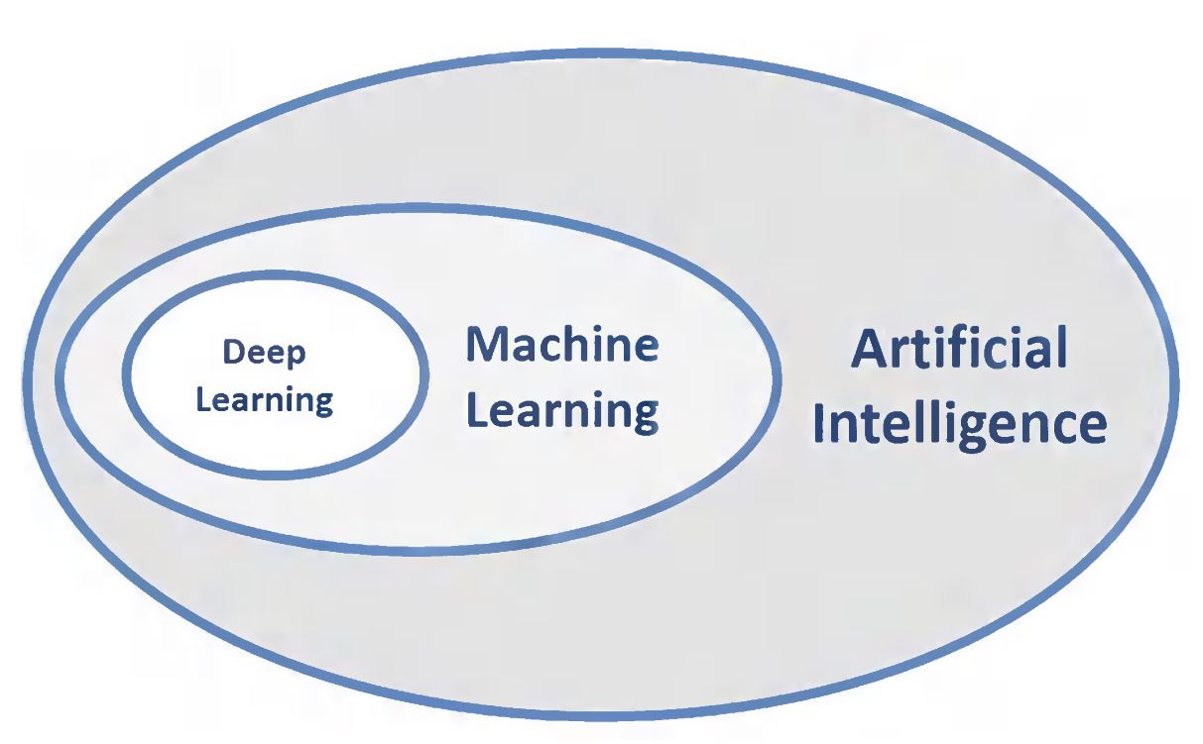
AI vs ML vs DL

Slide 6
AI History
1950
1980
2012
1973
1988
Turing test invented
Boom times
Deep learning revolution
First AI winter
Second AI winter

Slide 7
General context and problematic
Recognizing handwritten digits is a trivial task for human beings. However, it is not as simple for computers. And that’s because every person writes numbers differently. Our goal is to create an intelligent model capable of detecting those numbers. To achieve this goal, We will implement our model by applying a type of neural networks called CNN (convolutional neural network).

Slide 8
Handwritten
Digits
Recognition
Note:
In the following slides, we will explain the logic of our created model by illustrating the related concepts.

Slide 9

What are neural networks?
This image represents an image from the mnist Dataset of the
number 7. For a computer, this image is basically an array of pixels. We consider
each pixel as a neuron that has a value of 1 if it’s activated and a value of zero
Otherwise.
For this very task we need to use deep neural networks. But, what is
a neural network?

Slide 10
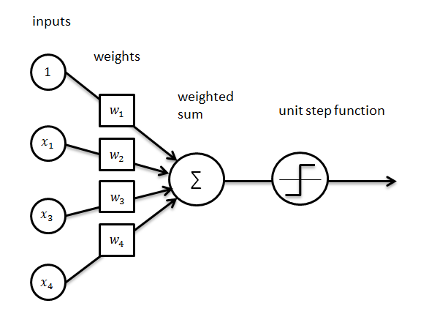
Perceptron
The smallest building block of neural networks.
A simple single layer neural network itself.

Slide 11
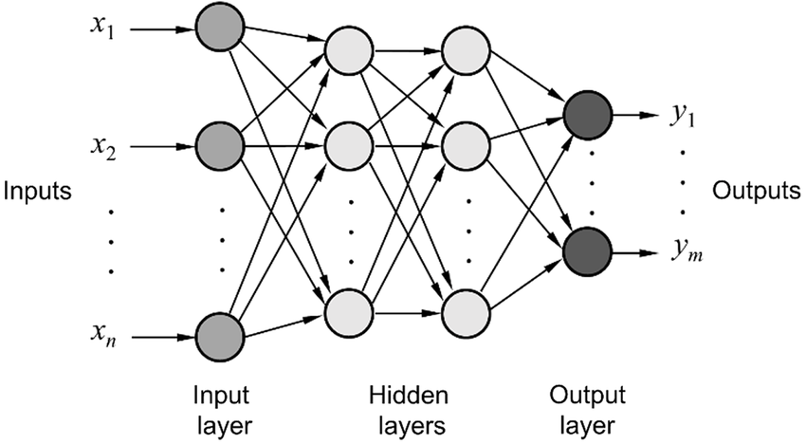
MLP
A combination of single perceptrons.
An input layer and an output layer with at least one hidden layer.
Each neuron is fully connected to the next layer’s neurons with a specific weight and a bias.

Slide 12
Why is an MLP not the ideal choice for image classification?
MLP uses too many parameters
MLP reacts differently to an input
Information is lost when the image is flattened(matrix to vector) into an MLP.

Slide 13
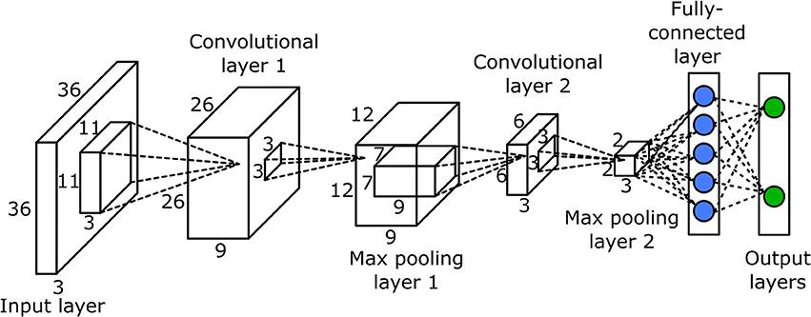
CNN
A special type of neural networks that is widely applied for image classification.
Convolutional layer.
Pooling layer.
Fully-connected layer.

Slide 14
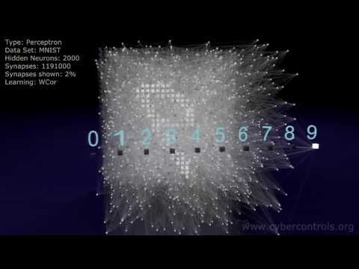
Neural networks
in action

Slide 15



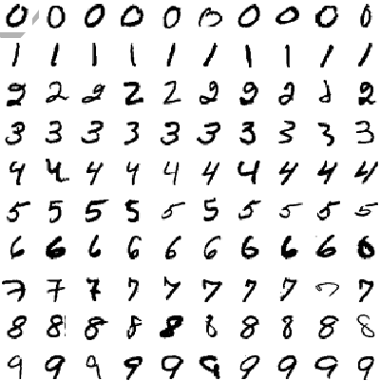

Development Tools

Slide 16
Simulation
We have implemented our CNN for handwritten digit classification here

Slide 17
Conclusion
The handwritten digit recognition using CNN has proved to be a fairly good efficiency.

Slide 18
Thank You
For Your Attention.
Source: github.com/hamzaaitbourhim/handwritten_digits_recognizer

